Slide 1
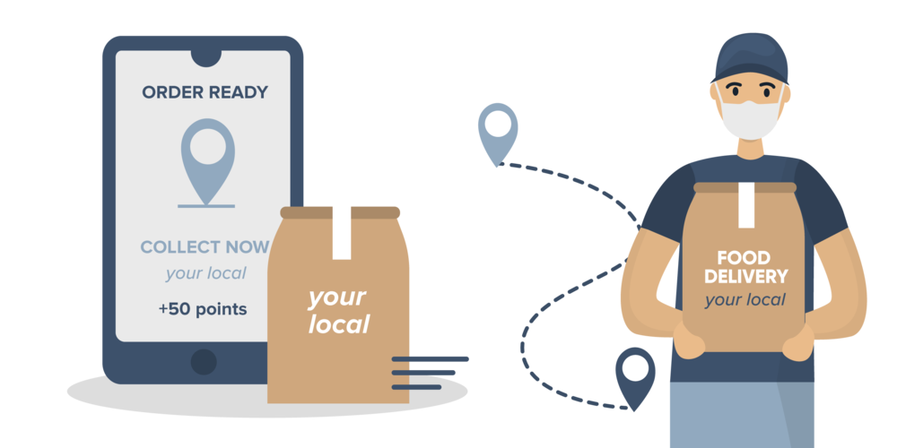
Zomato Restaurant Management System
Suman Bera
02/12/2024

Slide 2
agenda
Introduction 3
Brief Overview of Zomato as a Platform 4
Analytical Approach and Tools 5
Dashboard and Visualizations 10
Conclusion 13

Slide 3

Introduction
Zomato: Leading online food delivery and restaurant discovery platform.
Founded in 2008, Zomato has expanded globally, operating in numerous countries.
Offers a comprehensive database of restaurants, menus, reviews, and ratings.
Facilitates food ordering, table reservations, and food delivery services.

Slide 4
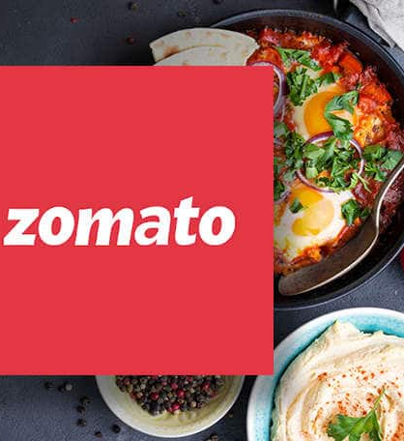
Brief Overview of Zomato as a Platform
Total number of restaurants across the world: 9551
Total countries served: 15
Total type of cuisines available throughout the world: 1825
Geographical coverage: Services reach 43 Indian cities, showing nationwide penetration.
Data cleaning and Preprocessing:
Unified product categories for a consistent classification across the platform
Addressed missing values in Cuisines section to enhance data integrity
This dataset allows for an in-depth understanding of Zomato’s market presence and operational scope.
Insights from user demographics and order volumes are key to optimizing marketing strategies and expanding product offerings.

Slide 5
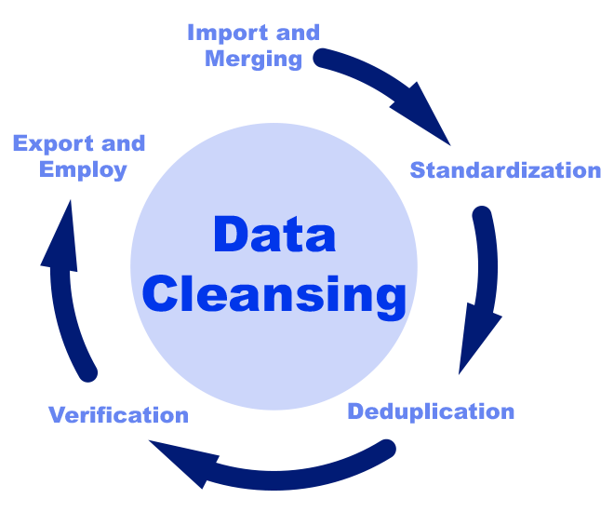
Analytical Approach and Tools
Data Cleaning: Utilized functions like Trim, and IF with Mode function to ensure data accuracy and dealing with the missing values.
Data Enrichment: Enhanced the dataset with additional variables using VLOOKUP and XLOOKUP to cross reference external data sources.
Descriptive Analysis: Employed Pivot Tables for summarizing key metrics and identifying distribution patterns across different regions and cuisines category.
Visualization: Created dynamic charts and dashboards for data representation, enabling interactive data exploration.

Slide 6
New restaurant opening ideas:
Country | Average of Rating | Restaurant Count
Australia | 3.7 | 24
Brazil | 3.8 | 60
Canada | 3.6 | 4
India | 2.8 | 8652
Indonesia | 4.3 | 21
New Zealand | 4.3 | 40
Philippines | 4.5 | 22
Qatar | 4.1 | 20
Singapore | 3.6 | 20
South Africa | 4.2 | 60
Sri Lanka | 3.9 | 20
Turkey | 4.3 | 34
United Arab Emirates | 4.2 | 60
United Kingdom | 4.1 | 80
United States of America | 4.0 | 434
Here we can see the data for opening new restaurants based on the aforementioned matrix:
We can see where the number of restaurants are lesser than 40, we can grow our business there.
We can also reach out to the places where the average rating of the food is equal to or above 3.6 to be considered to be a good show of ratings in terms of services provided.
From that ,we can conclude these countries to be ideal:
Australia, Canada, Indonesia, Philippines, Qatar, Singapore and Sri Lanka

Slide 7

Expenditure vs Ratings Analysis
As per the current calculation if we issue a pivot chart for average price range vs ratings and number of restaurants suggested, we can see that most of them falls between 2 and 3, and only Qatar and Singapore are at 4, where the ratings are good but no’s of restaurants are less.
People are liking more expensive food and ambience rather than cheaper options available.
The below mentioned graph shows the data exactly:

Slide 8
Biggest and lowest competitors:
Restaurants that are our biggest competitors in suggested countries: 72 in total are above 4.0 Rating.
Restaurants that are rated below 3: Only 7 found.
Restaurant Name | Rating
Mainland China Restaurant | 4.9
Ooma | 4.9
Ministry of Crab | 4.9
Spiral - Sofitel Philippine Plaza Manila | 4.9
Talaga Sampireun | 4.9
Sushi Masa | 4.9
Talaga Sampireun | 4.9
Restaurant Name | Rating
Pier 70 | 2.6
Consort Restaurant | 3
Makansutra Gluttons Bay | 3
Poets Cafe | 2.4
Star Buffet | 2.9
Elite Indian Restaurant | 2.4
Queen's Cafe | 2.5

Slide 9
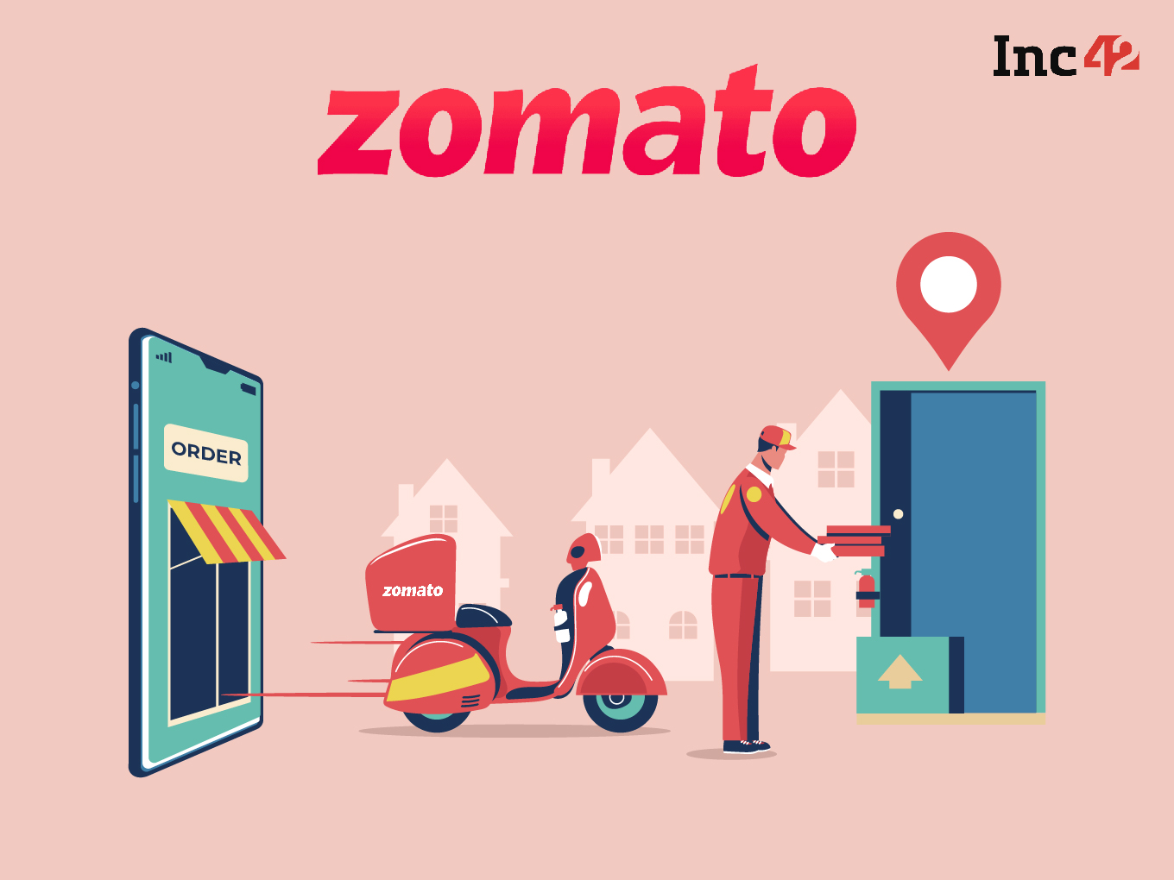
Explanation of approaches:
Analyzing Market Demand:
Use the "Number of Restaurants" and "Average Rating" metrics to identify countries/cities with high demand and positive reception for restaurants.
Utilize "Average_Cost_for_two" to understand the affordability factor in different areas.
Identifying Untapped Markets:
Examine countries/cities with fewer existing restaurants, potentially indicating underserved markets.
Look for locations with low competition but high population density or tourism traffic.
Assessing Economic Viability:
Consider the currency and average cost for two to evaluate the economic feasibility of opening a restaurant in different countries/cities.
Analyze GDP per capita and economic growth indicators of potential locations.

Slide 10
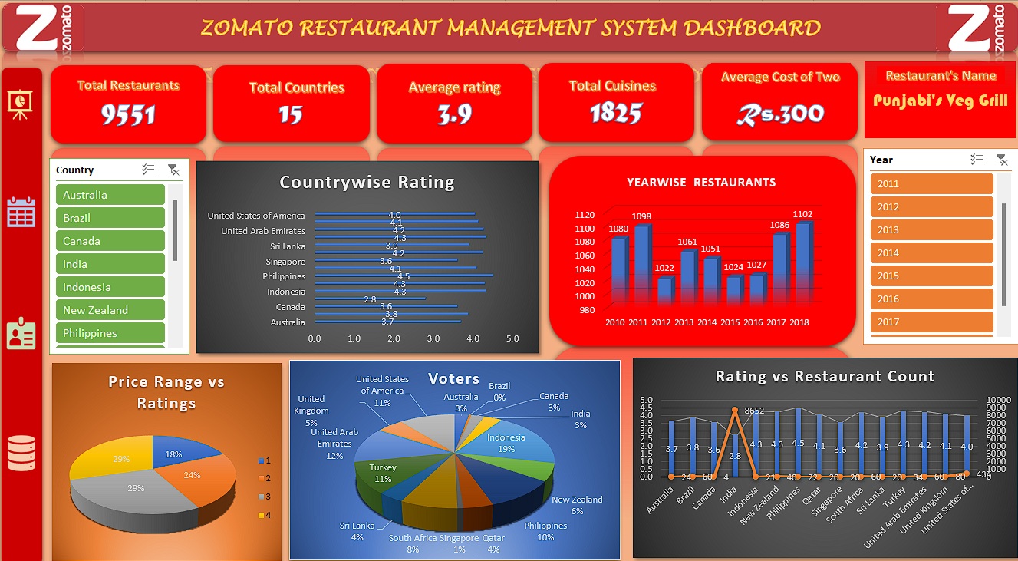
Dashboard and Visualizations

Slide 11
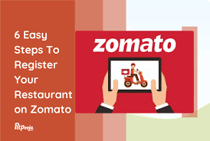
areas of focus
Key Visualization:
From the dashboard, we can check country wise rating w.r.t number of restaurants.
We can also check number of restaurants established year wise using interactive slicers
Also, we can check average rating of each country from the Dashboard using slicer feature.
We can check the “Average price for two using the dropdown menu by restaurant and currency wise to get a better understanding of the pricing.
The Dashboard also dictates regarding the relationship between pricing and ratings.

Slide 12
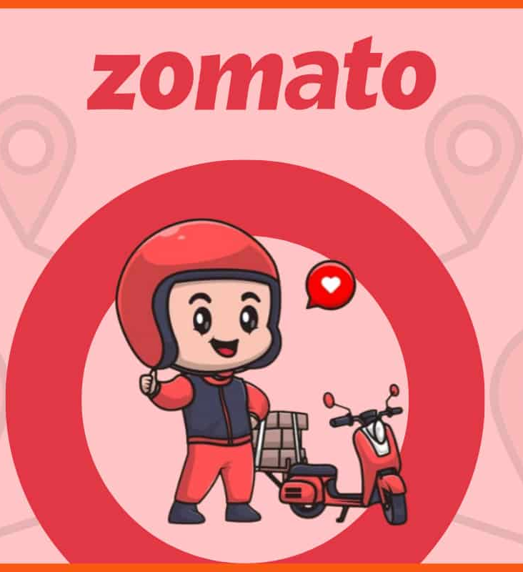
summary
In conclusion, the Zomato restaurant management system offers a comprehensive solution to streamline operations, improve efficiency, and enhance customer experiences in the hospitality industry. With its robust features such as order management, inventory tracking, and customer feedback analysis, Zomato empowers restaurant owners to optimize their processes and make data-driven decisions. By leveraging technology effectively, Zomato facilitates stronger connections between restaurants and their patrons, ultimately leading to greater satisfaction and loyalty. As we continue to embrace innovation in restaurant management, Zomato stands as a testament to the transformative power of technology in shaping the future of dining experiences.

Slide 13
Thank You
Suman Bera
sumanbera.123@outloolk.com

